Slide 1
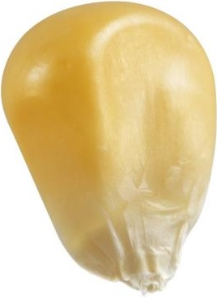
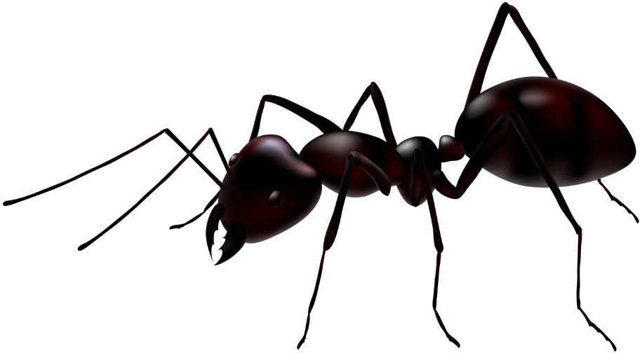
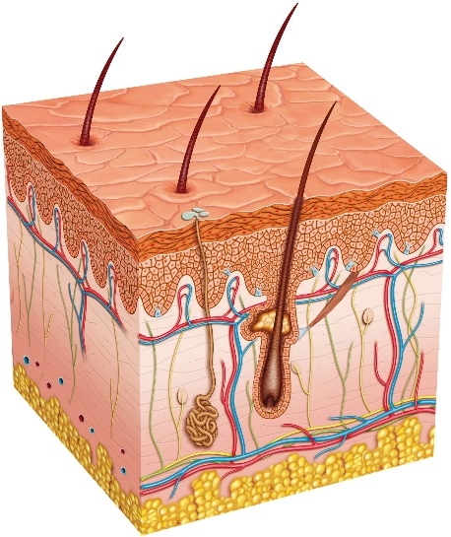
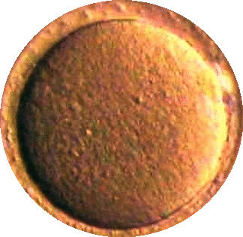
′morsel
1 ′lengthel 10⁰_{z} ′lengthel
4 biciaGrafut
Ant
′dermal
3 uncia′lengthel
1 biciaGrafut
1 uncia′lengthel
4 triciaGrafut
3 bicia′lengthel
1 triciaGrafut
′skin-like, ′line-like
Largest
Bacteria
Human
Skin
Corn Kernel
′kernel-like

Slide 2
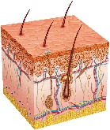
′pollical
3 ′lengthel
1 unciaGrafut 10⁻¹_{z} Grafut
′morsel
1 ′morsel
Ant
4 biciaGrafut
3 uncia′lengthel
1 biciaGrafut
1 uncia′lengthel
4 triciaGrafut
Human
Skin
Largest
Bacteria
Corn Kernel
′kernel-like
Sunflower Seed
′thumb-like, ′inch-like

Slide 3
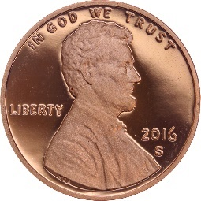
′manipular
1 unqua′lengthel 10¹_{z} ′lengthel
4 unciaGrafut
′pollical
3 ′lengthel
1 unciaGrafut
1 ′lengthel
4 biciaGrafut
3 uncia′lengthel
Quail
Egg
1 biciaGrafut
Corn
Kernel
Sunflower Seed
′thumb-like, ′inch-like
Softball
Chicken
Egg
Penny
′hand-like

Slide 4
′podial
3 unqua′lengthel
1 Grafut
′manipular
1 unqua′lengthel
4 unciaGrafut
Hummingbird
3 ′lengthel
1 unciaGrafut
1 ′lengthel
Quail
Egg
4 biciaGrafut
Softball
Chicken Egg
Penny
′hand-like
′foot-like

Slide 5
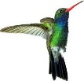
′ulnaral
1 biqua′lengthel 10²_{z} ′lengthel
4 Grafut
′brachial
′yard-like
′podial
3 unqua′lengthel
1 Grafut
1 unqua′lengthel
4 unciaGrafut
3 ′lengthel
1 unciaGrafut
′foot-like
Human
Basketball
′ell-like

Slide 6
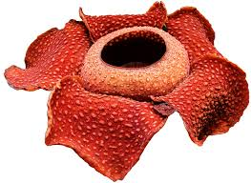
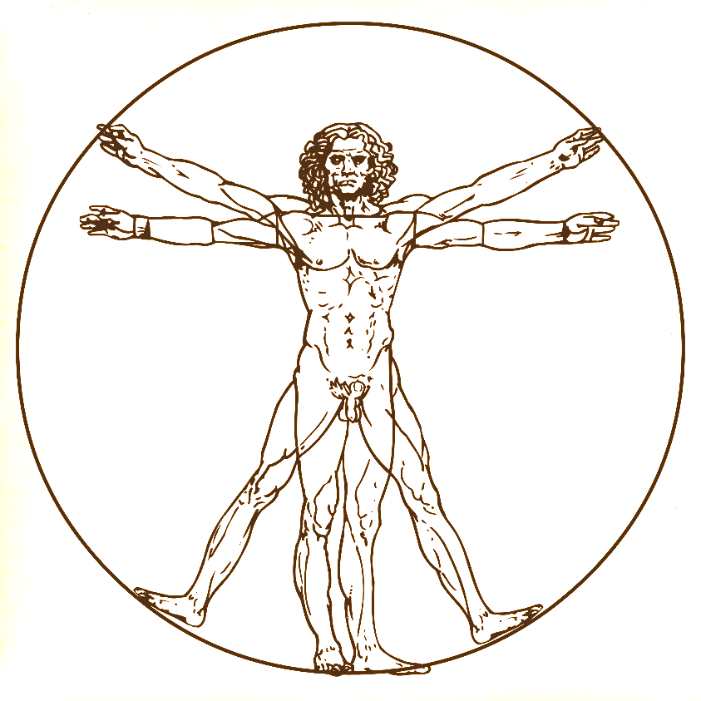
′chambral
3 biqua′lengthel
1 unquaGrafut 10_{z} Grafut
′ulnaral
Rafflesia
1 biqua′lengthel
4 Grafut
3 unqua′lengthel
1 Grafut
1 unqua′lengthel
4 unciaGrafut
Human
′ell-like
Dodo
′cameral, ′room-like

Slide 7
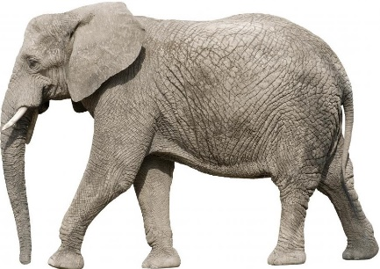
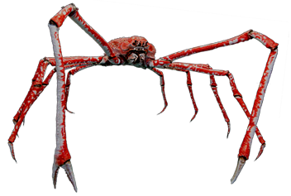
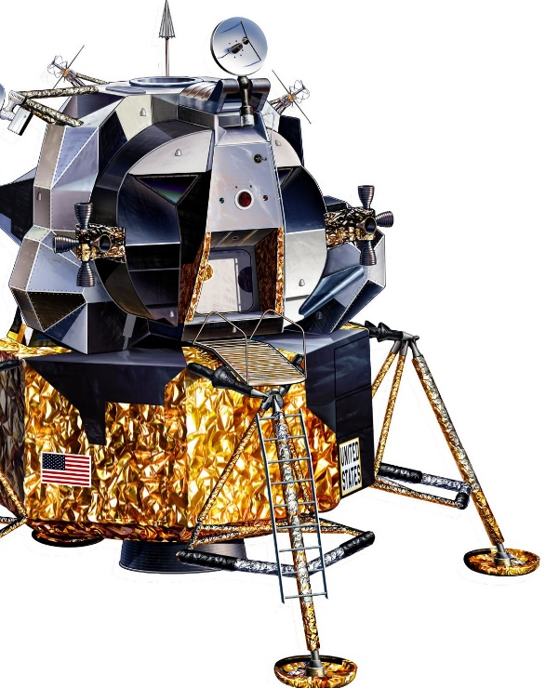
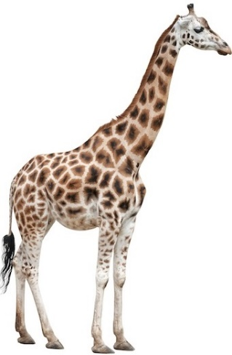
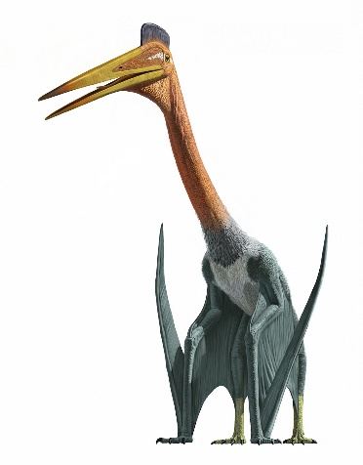
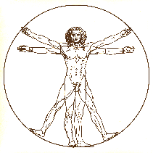
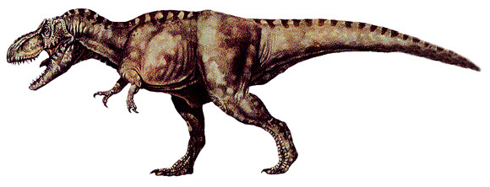
′habital
1 triqua′lengthel 10³_{z} ′lengthel
4 unquaGrafut
Floor Area of Average Home in the USA
Giant
Spider Crab
Elephant
′chambral
3 biqua′lengthel
1 unquaGrafut
1 biqua′lengthel
Rafflesia
4 Grafut
3 unqua′lengthel
1 Grafut
Human
Quetzalcoatlus
Dodo
Giraffe
′cameral, ′room-like
Lunar
Module
Tyrannosaur
Giant
Sunflower
′house-like

Slide 8
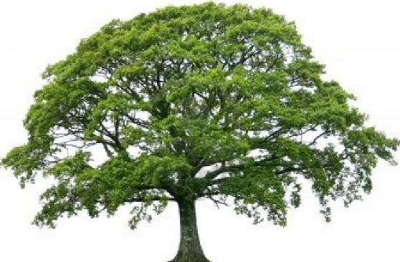
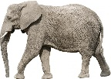
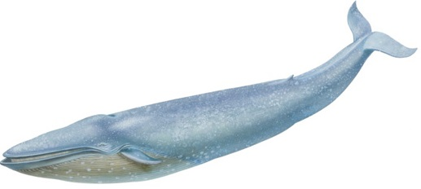
′colossal
3 triqua′lengthel
1 biquaGrafut 10²_{z} Grafut
Semi Tractor-Trailer
′habital
Oak Tree
1 triqua′lengthel
4 unquaGrafut
Giant
Spider Crab
Floor Area of Average Home in the USA
Elephant
3 biqua′lengthel
1 unquaGrafut
1 biqua′lengthel
4 Grafut
Giraffe
Quetzalcoatlus
Lunar Module
Tyrannosaur
Giant
Sunflower
′house-like
Blue Whale
′colossus-like

Slide 9
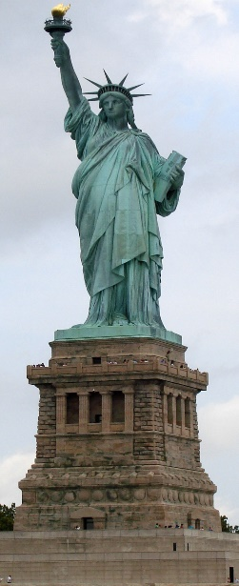
′stadial
1 quadqua′lengthel 10⁴_{z} ′lengthel
4 biquaGrafut
′colossal
Titanic
3 triqua′lengthel
1 biquaGrafut
1 triqua′lengthel
Oak Tree
Semi Tractor-Trailer
4 unquaGrafut
3 biqua′lengthel
Floor Area of Average Home in the USA
1 unqu′podial
Lunar
Module
Blue Whale
′colossus-like
Statue of Liberty
Boeing 747
′stadium-like
Saturn V

Slide 10
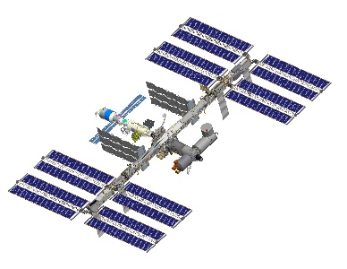
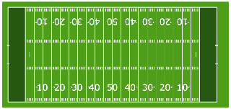
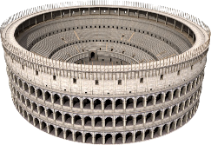
z
′turrial
3 quadqua′lengthel
1 triquaGrafut 10³_{z} Grafut
ISS
Football Field
′stadial
1 quadqua′lengthel
4 biquaGrafut
3 triqua′lengthel
Titanic
1 biquaGrafut
1 triqua′lengthel
4 unquaGrafut
Statue of Liberty
Boeing 747
′stade-like
Saturn V
Eiffel Tower
Sears Tower
Word Trade Center Towers
Empire State
Burj Khalifa
Colosseum
′tower-like

Slide 11
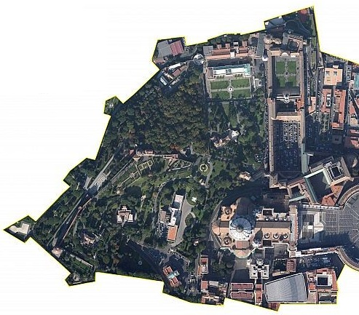
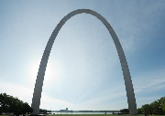
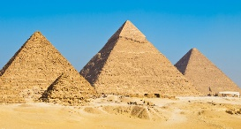
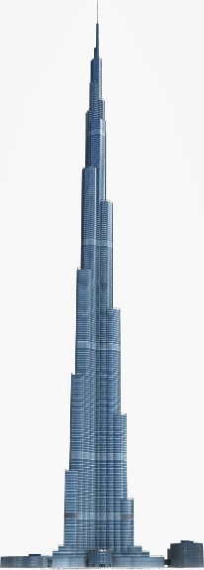
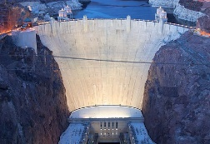
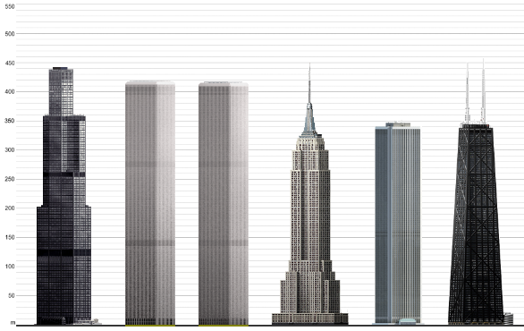
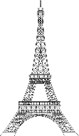
′dromal
1 pentqua′lengthel 10⁵_{z} ′lengthel
4 triquaGrafut
Gateway Arch
Great Pyramid
′turrial
3 quadqua′lengthel
1 triquaGrafut
Vatican
City
ISS
Hoover Dam
Football Field
1 quadqua′lengthel
4 biquaGrafut
3 triqua′lengthel
1 biquaGrafut
Eiffel Tower
Colosseum
Sears Tower
WTC Towers
Empire State
Std Oil
Burj Khalifa
Hancock
Tower
′tower-like
′kay-like
′mile-like
′road-like

Slide 12
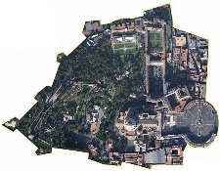
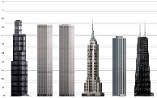
′parasangal
3 pentqua′lengthel
1 quadquaGrafut 10⁴_{z} Grafut
Central Park
′dromal
1 pentqua′lengthel
4 triquaGrafut
Gateway Arch
Great Pyramid
Phobos
3 quadqua′lengthel
Vatican
City
1 triquaGrafut
1 quadqua′lengthel
Hoover Dam
4 biquaGrafut
Burj Khalifa
Deimos
′kay-like
′mile-like
′road-like
′parasang-like

Slide 13
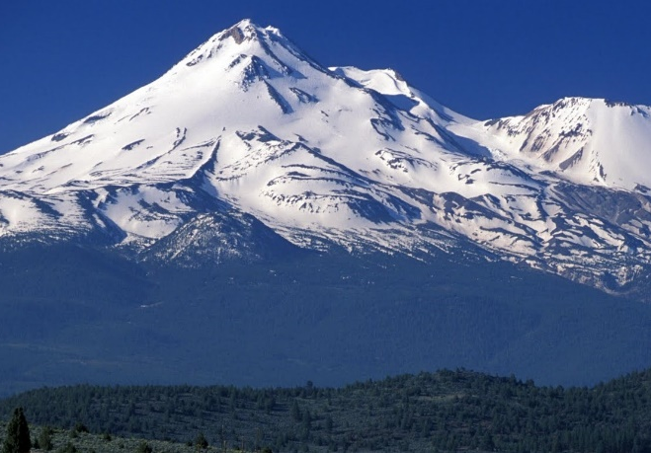
′itineral
1 hexqua′lengthel 10⁶_{z} ′lengthel
4 quadquaGrafut
Neutron Star
′parasangal
3 pentqua′lengthel
1 quadquaGrafut
1 pentqua′lengthel
Phobos
4 triquaGrafut
3 quadqua′lengthel
Deimos
1 triquaGrafut
Nix
′parasang-like
Mount Everest
′march-like, ′commute-like

Slide 14
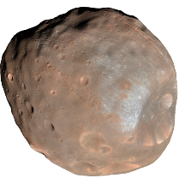
′provincial
3 hexqua′lengthel
1 pentquaGrafut 10⁵_{z} Grafut
′itineral
1 hexqua′lengthel
4 quadquaGrafut
3 pentqua′lengthel
Neutron Star
1 quadquaGrafut
1 pentqua′lengthel
Phobos
4 triquaGrafut
Deimos
Nix
Mount Everest
′march-like, ′commute-like
Hydra
Marathon
′province-like

Slide 15
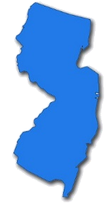
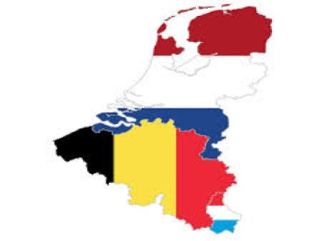
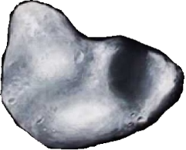
′regional
1 septqua′lengthel 10⁷_{z} ′lengthel
4 pentquaGrafut
′provincial
3 hexqua′lengthel
1 pentquaGrafut
1 hexqua′lengthel
Neutron Star
4 quadquaGrafut
3 pentqua′lengthel
Nix
1 quadquaGrafut
Everest
Marathon
Hydra
Rhode Island
′province-like
New Jersey
Benelux
′region-like

Slide 16
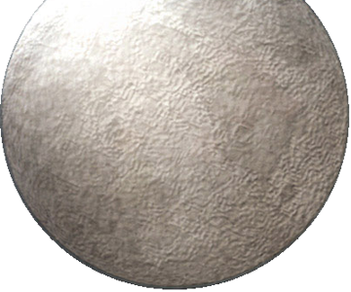
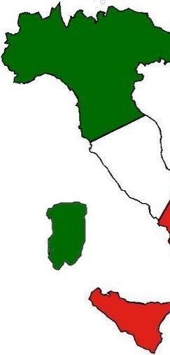
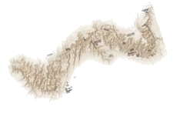
′territorial
3 septqua′lengthel
1 hexquaGrafut 10⁶_{z} Grafut
Disnomia
′regional
1 septqua′lengthel
4 pentquaGrafut
3 hexqua′lengthel
1 pentquaGrafut
1 hexqua′lengthel
4 quadquaGrafut
Hydra
Rhode Island
Benelux
′region-like
New Jersey
Grand Canyon
California
′country-like
Italy

Slide 17
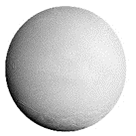
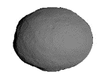
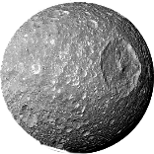
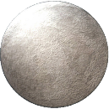
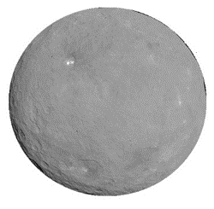
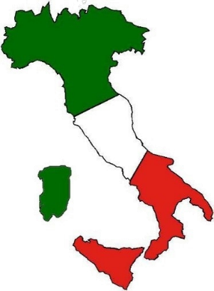
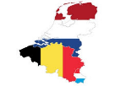
United States
′continental
1 octqua′lengthel 10⁸_{z} ′lengthel
4 hexquaGrafut
The Moon
Enceladus
Vesta
Mimas
′territorial
3 septqua′lengthel
1 hexquaGrafut
Disnomia
1 septqua′lengthel
4 pentquaGrafut
3 hexqua′lengthel
1 pentquaGrafut
Benelux
New Jersey
Ceres
Grand Canyon
′country-like
California
Italy
Texas
′continent-like

Slide 18
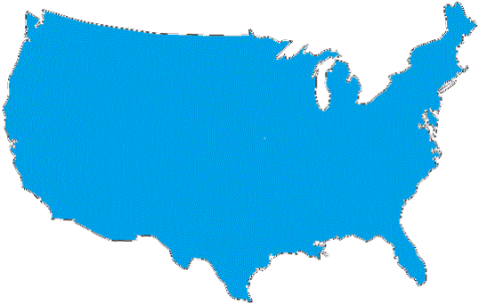
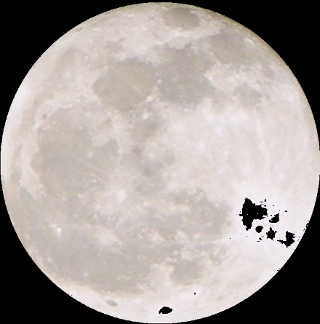
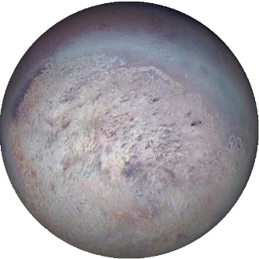
′quadrantal
3 octqua′lengthel
1 septquaGrafut 10⁷_{z} Grafut
United States
′continental
1 octqua′lengthel
4 hexquaGrafut
The Moon
Vesta
Enceladus
Mimas
3 septqua′lengthel
Disnomia
1 hexquaGrafut
1 septqua′lengthel
4 pentquaGrafut
Ceres
California
Italy
Texas
′continent-like
Pluto
Triton
Asia
Charon
′quadrant-like

Slide 19
′orbital
1 ennqua′lengthel 10⁹_{z} ′lengthel
4 septquaGrafut
Mercury
Mars
Uranus
Sirius B
′quadrantal
3 octqua′lengthel
Venus
1 septquaGrafut
1 octqua′lengthel
United States
The Moon
4 hexquaGrafut
3 septqua′lengthel
Ceres
1 hexquaGrafut
Pluto
Charon
Triton
Asia
Earth
′quadrant-like
The Four Gallilean Moons
Io
Titan
Europa
Callisto
Ganymede
′orbit-like, ′circumference-like

Slide 20
′gasgigantal
3 ennqua′lengthel
1 octquaGrafut 10⁸_{z} Grafut
Kepler-22b
′orbital
1 ennqua′lengthel
4 septquaGrafut
Sirius B
Mercury
Mars
Uranus
3 octqua′lengthel
Venus
1 septquaGrafut
1 octqua′lengthel
4 hexquaGrafut
Earth
Asia
The Four Gallilean Moons
Io
Callisto
Titan
Europa
Ganymede
′orbit-like, ′circumference-like
Minecraft World
Neptune
′gas-giant-like

Slide 21
′translunar
1 decqua′lengthel 10↊_{z} ′lengthel
4 octquaGrafut
Proxima
Centauri
Wolf 359
Gliese 229B
′gasgigantal
Luyten’s
Star
3 ennqua′lengthel
1 octquaGrafut
1 ennqua′lengthel
Kepler-22b
4 septquaGrafut
3 octqua′lengthel
Sirius B
Uranus
1 septquaGrafut
TrES-4b
Saturn
Neptune
Minecraft World
Jupiter
′gas-giant-like
Earth-Moon Distance
Sol
′lunar-orbit-like

Slide 22
′helial
3 decqua′lengthel
1 ennquaGrafut 10⁹_{z} Grafut
Gliese 229A
Alpha Centauri B
′translunar
1 decqua′lengthel
Proxima Centauri
4 octquaGrafut
Gliese 229B
Wolf 359
3 ennqua′lengthel
1 octquaGrafut
1 ennqua′lengthel
Luyten’s
Star
4 septquaGrafut
TrES-4b
Saturn
Jupiter
Earth-Moon Distance
′lunar-orbit-like
Alpha
Centauri A
Kapteyn’s
Star
Sol
′sun-like

Slide 23
Regulus
1 levqua′lengthel 10↋_{z} ′lengthel
Vega
4 ennquaGrafut
′helial
3 decqua′lengthel
Gliese 229A
Alpha Centauri B
1 ennquaGrafut
1 decqua′lengthel
4 octquaGrafut
3 ennqua′lengthel
1 octquaGrafut
Alpha
Centauri A
Sol
′sun-like
Procyon
Sirius A
Altair

Slide 24
3 levqua′lengthel
1 decquaGrafut 10↊_{z} Grafut
Regulus
1 levqua′lengthel
Vega
4 ennquaGrafut
3 decqua′lengthel
1 ennquaGrafut
1 decqua′lengthel
4 octquaGrafut
Procyon
Sirius A
Altair
Pollux
Spica

Slide 25
′planetarial
1 unnilqua′lengthel 10¹⁰_{z} ′lengthel
4 decquaGrafut
Arcturus
Albireo
3 levqua′lengthel
1 decquaGrafut
1 levqua′lengthel
Vega
Regulus
4 ennquaGrafut
3 decqua′lengthel
1 ennquaGrafut
Pollux
Polaris
Spica
Capella
Aldebaran
′planetary-orbit-like

Slide 26
Enif
3 unnilqua′lengthel
1 levquaGrafut 10↋_{z} Grafut
Rigel
′planetarial
1 unnilqua′lengthel
Arcturus
4 decquaGrafut
Albireo
3 levqua′lengthel
1 decquaGrafut
1 levqua′lengthel
4 ennquaGrafut
Polaris
Capella
Aldebaran
Alnitak
′planetary-orbit-like
Earth-Sun Distance
Gacrux

Slide 27
R Doradus
1 ununqua′lengthel 10¹¹_{z} ′lengthel
4 levquaGrafut
Pistol Star
Enif
3 unnilqua′lengthel
Rigel
1 levquaGrafut
1 unnilqua′lengthel
4 decquaGrafut
3 levqua′lengthel
1 decquaGrafut
Alnitak
Earth-Sun Distance
Gacrux
La Superba
Deneb

Slide 28
3 ununqua′lengthel
Antares
1 unnilquaGrafut 10¹⁰_{z} Grafut
V354
Cephei
BetelGeuse
R Doradus
1 ununqua′lengthel
4 levquaGrafut
Pistol Star
3 unnilqua′lengthel
1 levquaGrafut
1 unnilqua′lengthel
4 decquaGrafut
La Superba
Deneb
Mu Cephei
KY Cygni

Slide 29
1 unbiqua′lengthel 10¹²_{z} ′lengthel
4 unnilquaGrafut
V V Cephei A
WOH G84
3 ununqua′lengthel
Betelgeuse
Antares
V354 Cephei
1 unnilquaGrafut
1 ununqua′lengthel
4 levquaGrafut
3 unnilqua′lengthel
1 levquaGrafut
Kuiper Belt
Mu Cephei
KY Cygni
VY Canis Majoris
Neptune-Sun Distance

Slide 30
3 unbiqua′lengthel
1 ununquaGrafut 10¹¹_{z} Grafut
Light-Day
1 unbiqua′lengthel
4 unnilquaGrafut
3 ununqua′lengthel
1 unnilquaGrafut
1 ununqua′lengthel
Kuiper Belt
4 levquaGrafut
Homunculus
Nebula

Slide 31
1 untriqua′lengthel 10¹³_{z} ′lengthel
4 ununquaGrafut
Sedna-Sun Aphelion
3 unbiqua′lengthel
Light-Day
1 ununquaGrafut
1 unbiqua′lengthel
4 unnilquaGrafut
3 ununqua′lengthel
1 unnilquaGrafut
Homunculus Nebula

Slide 32
3 untriqua′lengthel
1 unbiquaGrafut 10¹²_{z} Grafut
1 untriqua′lengthel
Sedna-Sun Aphelion
4 ununquaGrafut
3 unbiqua′lengthel
1 ununquaGrafut
1 unbiqua′lengthel
4 unnilquaGrafut
Stingray
Nebula

Slide 33
1 unquadqua′lengthel 10¹⁴_{z} ′lengthel
~2 uncialightyear
~0.2_{z} lightyear
4 unbiquaGrafut
Light-Month
Cat’s Eye
Nebula
Stingray
Nebula
3 untriqua′lengthel
1 unbiquaGrafut
1 untriqua′lengthel
4 ununquaGrafut
3 unbiqua′lengthel
1 ununquaGrafut

Slide 34
3 unquadqua′lengthel
1 untriquaGrafut 10¹³_{z} Grafut
~6 uncialightyear ~0.6_{z} lightyear
Cat’s Eye
Nebula
1 unquadqua′lengthel
Light-Month
4 unbiquaGrafut
3 untriqua′lengthel
Stingray Nebula
1 unbiquaGrafut
1 untriqua′lengthel
4 ununquaGrafut
Gomez’s Hamburger
Hourglass
Nebula

Slide 35
′oortial
1 unpentqua′lengthel 10¹⁵_{z} ′lengthel
~2 lightyear
4 untriquaGrafut
Light-Year
Eskimo Nebula
′?-al
3 unquadqua′lengthel
1 untriquaGrafut
1 unquadqua′lengthel
Cat’s Eye
Nebula
4 unbiquaGrafut
3 untriqua′lengthel
Gomez’s
Hamburger
1 unbiquaGrafut
Hourglass Nebula
′?-like
Blinking Nebula
Rotten Egg Nebula
Ring Nebula
′oort-cloud-like

Slide 36
3 unpentqua′lengthel
1 unquadquaGrafut 10¹⁴_{z} Grafut
~6 lightyear
Ant Nebula
′oortial
1 unpentqua′lengthel
Light-Year
4 untriquaGrafut
Eskimo Nebula
Horsehead Nebula
3 unquadqua′lengthel
1 untriquaGrafut
1 unquadqua′lengthel
4 unbiquaGrafut
Ring Nebula
′oort-cloud-like
Rotten Egg Nebula
Oort Cloud
Boomerang Nebula
Helix Nebula

Slide 37
1 unhexqua′lengthel 10¹⁶_{z} ′lengthel
~2 unqualightyear ~2·10¹_{z} lightyear
4 unquadquaGrafut
Bubble Nebula
3 unpentqua′lengthel
1 unquadquaGrafut
1 unpentqua′lengthel
Ant Nebula
4 untriquaGrafut
3 unquadqua′lengthel
Horsehead
Nebula
1 untriquaGrafut
Oort Cloud
Boomerang
Nebula
Helix Nebula
Pillars of Creation
Cone Nebula
Crab Nebula

Slide 38
3 unhexqua′lengthel
1 unpentquaGrafut 10¹⁵_{z} Grafut
~ 6 unqualightyear ~6·10¹_{z} lightyear
1 unhexqua′lengthel
The Spire
4 unquadquaGrafut
3 unpentqua′lengthel
Bubble Nebula
1 unquadquaGrafut
1 unpentqua′lengthel
4 untriquaGrafut
North American Nebula
Cone Nebula
Pillars of Creation
Crab Nebula
Orion Nebula

Slide 39
1 unseptqua′lengthel 10¹⁷_{z} ′lengthel
~2 biqualightyear ~2·10²_{z} lightyear
4 unpentquaGrafut
Eagle Nebula
Great Nebula in Carina
3 unhexqua′lengthel
1 unpentquaGrafut
1 unhexqua′lengthel
4 unquadquaGrafut
3 unpentqua′lengthel
North American Nebula
1 unquadquaGrafut
Orion Nebula
Rosette Nebula
Omega Centauri
Cave Nebula

Slide 40
3 unseptqua′lengthel
1 unhexquaGrafut 10¹⁶_{z} Grafut
~6 biqualightyear ~6·10²_{z} lightyear
1 unseptqua′lengthel
Barnard’s
Loop
4 unpentquaGrafut
3 unhexqua′lengthel
1 unpentquaGrafut
1 unhexqua′lengthel
4 unquadquaGrafut
Rosette Nebula
Omega Centauri
Tarantula Nebula
Messier 54

Slide 41
1 unoctqua′lengthel 10¹⁸_{z} ′lengthel
~2 triqualightyear ~2·10³_{z} lightyear
4 unhexquaGrafut
3 unseptqua′lengthel
1 unhexquaGrafut
1 unseptqua′lengthel
4 unpentquaGrafut
3 unhexqua′lengthel
1 unpentquaGrafut
Leo II Dwarf Galaxy
Tarantula Nebula
Messier 54
Canes Venatici Dwarf Galaxy

Slide 42
3 unoctqua′lengthel
1 unseptquaGrafut 10¹⁷_{z} Grafut
~6 triqualightyear ~6·10³_{z} lightyear
Small Magellanic
Cloud
1 unoctqua′lengthel
4 unhexquaGrafut
3 unseptqua′lengthel
1 unhexquaGrafut
1 unseptqua′lengthel
Leo II Dwarf Galaxy
4 unpentquaGrafut
Canes Venatici Dwarf Galaxy

Slide 43
1 unennqua′lengthel 10¹⁹_{z} ′lengthel
~2 quadqualightyear ~2·10⁴_{z} lightyear
4 unseptquaGrafut
3 unoctqua′lengthel
1 unseptquaGrafut
1 unoctqua′lengthel
Small Magellanic
Cloud
4 unhexquaGrafut
3 unseptqua′lengthel
1 unhexquaGrafut
NGC 3310
Large Magellanic Cloud
Triangulum
Galaxy

Slide 44
′galactical
3 unennqua′lengthel
1 unoctquaGrafut 10¹⁸_{z} Grafut
~6 quadqualightyear ~6·10⁴_{z} lightyear
1 unennqua′lengthel
4 unseptquaGrafut
3 unoctqua′lengthel
1 unseptquaGrafut
1 unoctqua′lengthel
4 unhexquaGrafut
NGC 3310
Triangulum
Galaxy
Andromeda
Galaxy
Sombrero Galaxy
Milky Way
Galaxy
′galaxy-like

Slide 45
1 undecqua′lengthel 10^{1↊} _{z} ′lengthel
~2 pentqualightyear ~2·10⁵_{z} lightyear
4 unoctquaGrafut
′galactical
NGC 1232
3 unennqua′lengthel
1 unoctquaGrafut
1 unennqua′lengthel
4 unseptquaGrafut
Cartwheel
Galaxy
3 unoctqua′lengthel
1 unseptquaGrafut
Virgo A Galaxy
Andromeda
Galaxy
′galaxy-like
Milky Way
Galaxy
Whirlpool
Galaxy
Tadpole Galaxy
Pinwheel Galaxy

Slide 46
3 undecqua′lengthel
1 unennquaGrafut 10¹⁹_{z} Grafut
~6 pentqualightyear ~6·10⁵_{z} lightyear
1 undecqua′lengthel
4 unoctquaGrafut
3 unennqua′lengthel
1 unoctquaGrafut
1 unennqua′lengthel
4 unseptquaGrafut
NGC 4889D

Slide 47
1 unlevqua′lengthel 10^{1↋} _{z} ′lengthel
~2 hexqualightyear ~2·10⁶_{z} lightyear
4 unennquaGrafut
Distance to Andromeda Galaxy
Local Group
3 undecqua′lengthel
1 unennquaGrafut
1 undecqua′lengthel
4 unoctquaGrafut
3 unennqua′lengthel
1 unoctquaGrafut
IC 1011

Slide 48
3 unlevqua′lengthel
1 undecquaGrafut 10^{1↊} _{z} Grafut
~6 hexqualightyear ~6·10⁶_{z} lightyear
Fornax Cluster
1 unlevqua′lengthel
4 unennquaGrafut
Local Group
3 undecqua′lengthel
1 unennquaGrafut
1 undecqua′lengthel
4 unoctquaGrafut
IC 1011
Abell 2029

Slide 49
1 binilqua′lengthel 10²⁰ _{z} ′lengthel
~2 septqualightyear ~2·10⁷_{z} lightyear
4 undecquaGrafut
Fornax Cluster
3 unlevqua′lengthel
1 undecquaGrafut
1 unlevqua′lengthel
4 unennquaGrafut
3 undecqua′lengthel
1 unennquaGrafut
Virgo Cluster

Slide 50
3 binilqua′lengthel
1 unlevquaGrafut 10^{1↋} _{z} Grafut
~6 septqualightyear ~6·10⁷_{z} lightyear
1 binilqua′lengthel
4 undecquaGrafut
3 unlevqua′lengthel
1 undecquaGrafut
1 unlevqua′lengthel
4 unennquaGrafut
Virgo Supercluster

Slide 51
1 biunqua′lengthel 10²¹ _{z} ′lengthel
~2 octqualightyear ~2·10⁸_{z} lightyear
4 unlevquaGrafut
3 binilqua′lengthel
1 unlevquaGrafut
1 binilqua′lengthel
Virgo Supercluster
4 undecquaGrafut
3 unlevqua′lengthel
1 undecquaGrafut
Eridanus
Supervoid
Pisces-Cetus
Supercluster
Complex

Slide 52
3 biunqua′lengthel
1 binilquaGrafut 10²⁰ _{z} Grafut
~6 octqualightyear ~6·10⁸_{z} lightyear
Sloan Great Wall
1 biunqua′lengthel
4 unlevquaGrafut
3 binilqua′lengthel
1 unlevquaGrafut
1 binilqua′lengthel
Eridanus
Supervoid
4 undecquaGrafut
Pisces-Cetus
Supercluster
Complex

Slide 53
1 bibiqua′lengthel 10²² _{z} ′lengthel
~2 ennqualightyear ~2·10⁹_{z} lightyear
4 binilquaGrafut
3 biunqua′lengthel
1 binilquaGrafut
1 biunqua′lengthel
4 unlevquaGrafut
3 binilqua′lengthel
1 unlevquaGrafut
Distance to Hubble Deep Field

Slide 54
3 bibiqua′lengthel
1 biunquaGrafut 10²¹ _{z} Grafut
~6 ennqualightyear ~6·10⁹_{z} lightyear
1 bibiqua′lengthel
4 binilquaGrafut
3 biunqua′lengthel
1 binilquaGrafut
1 biunqua′lengthel
4 unlevquaGrafut

Slide 55
′universal
1 bitriqua′lengthel 10²³ _{z} ′lengthel
~2 decqualightyear ~2·10↊_{z} lightyear
4 biunquaGrafut
3 bibiqua′lengthel
1 biunquaGrafut
1 bibiqua′lengthel
4 binilquaGrafut
3 biunqua′lengthel
1 binilquaGrafut
Observable Universe ~ 1.8_{z} decqualightyear
′universe-like

Slide 57
Resources about Primel
Primel Metrology Wiki:
http://primel-metrology.wikia.com
Primel Metrology Forum:
http://z13.invisionfree.com/DozensOnline/index.php?showforum=30

