Slide 1
1 undeccia′lengthel 10^{−1↊}_{z} ′lengthel
4 binilciaGrafut
3 unlevcia′lengthel
1 binilciaGrafut
1 unlevcia′lengthel
4 biunciaGrafut
3 binilcia′lengthel
1 biunciaGrafut

Slide 2
3 undeccia′lengthel
1 unlevciaGrafut 10^{−1↋}_{z} Grafut
1 undeccia′lengthel
4 binilciaGrafut
3 unlevcia′lengthel
1 binilciaGrafut
1 unlevcia′lengthel
4 biunciaGrafut

Slide 3
1 unenncia′lengthel 10⁻¹⁹_{z} ′lengthel
4 unlevciaGrafut
3 undeccia′lengthel
1 unlevciaGrafut
1 undeccia′lengthel
4 binilciaGrafut
3 unlevcia′lengthel
1 binilciaGrafut

Slide 4
3 unenncia′lengthel
1 undecciaGrafut 10^{−1↊}_{z} Grafut
Neutrino
1 unenncia′lengthel
4 unlevciaGrafut
3 undeccia′lengthel
1 unlevciaGrafut
1 undeccia′lengthel
4 binilciaGrafut

Slide 5
′neutrinal
1 unoctcia′lengthel 10⁻¹⁸_{z} ′lengthel
4 undecciaGrafut
3 unenncia′lengthel
1 undecciaGrafut
1 unenncia′lengthel
4 unlevciaGrafut
3 undeccia′lengthel
Neutrino
1 unlevciaGrafut
′neutrino-like

Slide 6
3 unoctcia′lengthel
1 unennciaGrafut 10⁻¹⁹_{z} Grafut
′neutrinal
1 unoctcia′lengthel
4 undecciaGrafut
3 unenncia′lengthel
1 undecciaGrafut
1 unenncia′lengthel
Neutrino
4 unlevciaGrafut
′neutrino-like

Slide 7
1 unseptcia′lengthel 10⁻¹⁷_{z} ′lengthel
4 unennciaGrafut
3 unoctcia′lengthel
1 unennciaGrafut
1 unoctcia′lengthel
4 undecciaGrafut
3 unenncia′lengthel
Neutrino
1 undecciaGrafut

Slide 8
3 unseptcia′lengthel
1 unoctciaGrafut 10⁻¹⁸_{z} Grafut
Top Quark
1 unseptcia′lengthel
4 unennciaGrafut
3 unoctcia′lengthel
1 unennciaGrafut
1 unoctcia′lengthel
4 undecciaGrafut

Slide 9
1 unhexcia′lengthel 10⁻¹⁶_{z} ′lengthel
4 unoctciaGrafut
3 unseptcia′lengthel
Top Quark
1 unoctciaGrafut
1 unseptcia′lengthel
4 unennciaGrafut
3 unoctcia′lengthel
1 unennciaGrafut

Slide 10
3 unhexcia′lengthel
1 unseptciaGrafut 10⁻¹⁷_{z} Grafut
1 unhexcia′lengthel
4 unoctciaGrafut
3 unseptcia′lengthel
Top Quark
1 unoctciaGrafut
1 unseptcia′lengthel
4 unennciaGrafut

Slide 11
1 unpentcia′lengthel 10⁻¹⁵_{z} ′lengthel
4 unseptciaGrafut
3 unhexcia′lengthel
1 unseptciaGrafut
1 unhexcia′lengthel
4 unoctciaGrafut
3 unseptcia′lengthel
1 unoctciaGrafut

Slide 12
3 unpentcia′lengthel
1 unhexciaGrafut 10⁻¹⁶_{z} Grafut
1 unpentcia′lengthel
4 unseptciaGrafut
3 unhexcia′lengthel
1 unseptciaGrafut
1 unhexcia′lengthel
4 unoctciaGrafut
Bottom Quark

Slide 13
Charm Quark
1 unquadcia′lengthel 10⁻¹⁴_{z} ′lengthel
4 unhexciaGrafut
3 unpentcia′lengthel
1 unhexciaGrafut
1 unpentcia′lengthel
4 unseptciaGrafut
3 unhexcia′lengthel
1 unseptciaGrafut
Bottom Quark

Slide 14
3 unquadcia′lengthel
Charm Quark
1 unpentciaGrafut 10⁻¹⁵_{z} Grafut
1 unquadcia′lengthel
4 unhexciaGrafut
3 unpentcia′lengthel
1 unhexciaGrafut
1 unpentcia′lengthel
4 unseptciaGrafut
Bottom Quark
Strange Quark

Slide 15
′gluonal
1 untricia′lengthel 10⁻¹³_{z} ′lengthel
4 unpentciaGrafut
3 unquadcia′lengthel
Charm Quark
1 unpentciaGrafut
1 unquadcia′lengthel
4 unhexciaGrafut
3 unpentcia′lengthel
1 unhexciaGrafut
Strange Quark
′quark-like

Slide 16
3 untricia′lengthel
1 unquadciaGrafut 10⁻¹⁴_{z} Grafut
′gluonal
1 untricia′lengthel
4 unpentciaGrafut
3 unquadcia′lengthel
Charm Quark
1 unpentciaGrafut
1 unquadcia′lengthel
4 unhexciaGrafut
Up Quark
Down Quark
Strange Quark
′quark-like

Slide 17
1 unbicia′lengthel 10⁻¹²_{z} ′lengthel
4 unquadciaGrafut
3 untricia′lengthel
1 unquadciaGrafut
1 untricia′lengthel
4 unpentciaGrafut
3 unquadcia′lengthel
Up Quark
Down Quark
1 unpentciaGrafut
Strang Quark

Slide 18
3 unbicia′lengthel
1 untriciaGrafut 10⁻¹³_{z} Grafut
1 unbicia′lengthel
4 unquadciaGrafut
3 untricia′lengthel
1 unquadciaGrafut
1 untricia′lengthel
4 unpentciaGrafut
Range of Weak Force

Slide 19
1 ununcia′lengthel 10⁻¹¹_{z} ′lengthel
4 untriciaGrafut
3 unbicia′lengthel
1 untriciaGrafut
1 unbicia′lengthel
4 unquadciaGrafut
3 untricia′lengthel
1 unquadciaGrafut
Range of Weak Force

Slide 20
3 ununcia′lengthel
1 unbiciaGrafut 10⁻¹²_{z} Grafut
1 ununcia′lengthel
4 untriciaGrafut
3 unbicia′lengthel
1 untriciaGrafut
1 unbicia′lengthel
4 unquadciaGrafut

Slide 21
1 unnilcia′lengthel 10⁻¹⁰_{z} ′lengthel
4 unbiciaGrafut
3 ununcia′lengthel
1 unbiciaGrafut
1 ununcia′lengthel
4 untriciaGrafut
3 unbicia′lengthel
1 untriciaGrafut

Slide 22
′hadronal
3 unnilcia′lengthel
1 ununciaGrafut 10⁻¹¹_{z} Grafut
1 unnilcia′lengthel
4 unbiciaGrafut
3 ununcia′lengthel
1 unbiciaGrafut
1 ununcia′lengthel
4 untriciaGrafut
Proton
Neutron
′hadron-like

Slide 23
′nuclear
1 levcia′lengthel 10^{−↋}_{z} ′lengthel
4 ununciaGrafut
Helium
Nucleus
e⁻
′hadronal
Size limit of Electron (Classical)
3 unnilcia′lengthel
1 ununciaGrafut
1 unnilcia′lengthel
4 unbiciaGrafut
3 unnuncia′lengthel
1 unbiciaGrafut
Proton
Neutron
′hadron-like
′atomic-nucleus-like

Slide 24
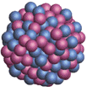
3 levcia′lengthel
1 unnilciaGrafut 10⁻¹⁰_{z} Grafut
Uranium Nucleus
′nuclear
1 levcia′lengthel
Helium
Nucleus
4 ununciaGrafut
e⁻
3 unnilcia′lengthel
Size Limit of Electron
(Classical)
1 ununciaGrafut
1 unnilcia′lengthel
4 unbiciaGrafut
Proton
Neutron
Carbon Nuclei
′atomic-nucleus-like
¹²C
¹³C
¹⁴C

Slide 25
1 deccia′lengthel 10^{−↊}_{z} ′lengthel
4 unnilciaGrafut
3 levcia′lengthel
1 unnilciaGrafut
1 levcia′lengthel
Uranium Nucleus
4 ununciaGrafut
3 unnilcia′lengthel
1 ununciaGrafut
Carbon Nuclei

Slide 26
3 deccia′lengthel
1 levciaGrafut 10^{−↋}_{z} Grafut
1 deccia′lengthel
4 unnilciaGrafut
3 levcia′lengthel
1 unnilciaGrafut
1 levcia′lengthel
4 ununciaGrafut

Slide 27
1 enncia′lengthel 10⁻⁹_{z} ′lengthel
4 levciaGrafut
3 deccia′lengthel
1 levciaGrafut
1 decia′lengthel
4 unnilciaGrafut
3 levcia′lengthel
1 unnilciaGrafut

Slide 28
3 enncia′lengthel
1 decciaGrafut 10^{−↊}_{z} Grafut
1 enncia′lengthel
4 levciaGrafut
3 deccia′lengthel
1 levciaGrafut
1 deccia′lengthel
4 unnilciaGrafut

Slide 29
1 octcia′lengthel 10⁻⁸_{z} ′lengthel
4 decciaGrafut
3 enncia′lengthel
1 decciaGrafut
1 enncia′lengthel
4 levciaGrafut
3 deccia′lengthel
1 levciaGrafut

Slide 30
′nephellar
3 octcia′lengthel
1 ennciaGrafut 10⁻⁹_{z} Grafut
1 octcia′lengthel
4 decciaGrafut
3 enncia′lengthel
1 decciaGrafut
1 enncia′lengthel
4 levciaGrafut
Hydrogen
Atom
Helium
Atom
′electron-shell-like

Slide 31
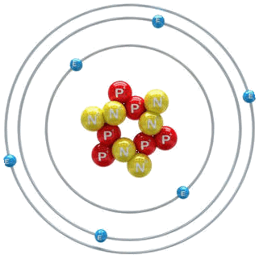
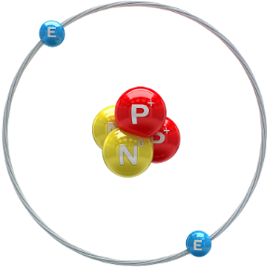
′atomical
1 septcia′lengthel 10⁻⁷_{z} ′lengthel
4 ennciaGrafut
′nephellar
3 octcia′lengthel
1 ennciaGrafut
1 octcia′lengthel
4 decciaGrafut
3 enncia′lengthel
1 decciaGrafut
Cesium
Atom
Hydrogen Atom
′electron-shell-like
Helium Atom
Electron
Microscope Resolution
Carbon
Atom
′atom-like

Slide 32
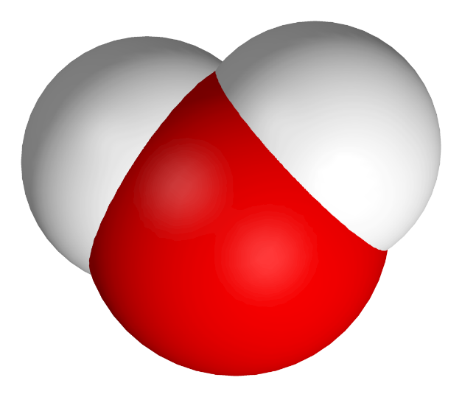
′molecular
3 septcia′lengthel
1 octciaGrafut 10⁻⁸_{z} Grafut
Water
Molecule
′atomical
1 septcia′lengthel
4 ennciaGrafut
3 octcia′lengthel
Cesium
Atom
1 ennciaGrafut
1 octcia′lengthel
4 decciaGrafut
Carbon Atom
′atom-like
Glucose
Buckyball
′molecule-like

Slide 33
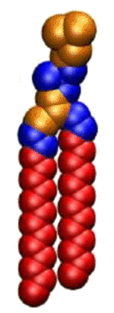
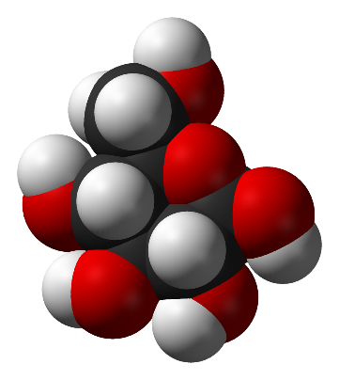
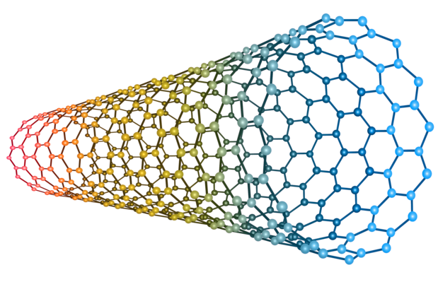
′polymeral
1 hexcia′lengthel 10⁻⁶_{z} ′lengthel
4 octciaGrafut
Carbon
Nanotube
′molecular
3 septcia′lengthel
1 octciaGrafut
1 septcia′lengthel
4 ennciaGrafut
3 octcia′lengthel
1 ennciaGrafut
′molecule-like
Glucose
Buckyball
′polymer-like
Phospholipid

Slide 34
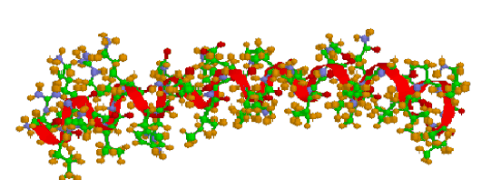
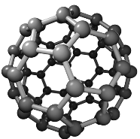
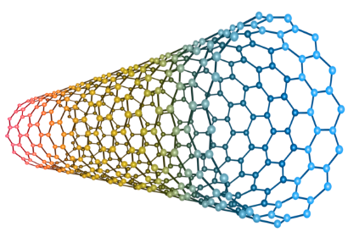
′membranal
3 hexcia′lengthel
1 septciaGrafut 10⁻⁷_{z} Grafut
Alpha Helix
′polymeral
1 hexcia′lengthel
Carbon
Nanotube
4 octciaGrafut
3 septcia′lengthel
1 octciaGrafut
1 septcia′lengthel
4 ennciaGrafut
Glucose
Buckyball
′polymer-like
Phospholipid
′cell-membrane-like

Slide 35
′somal
1 pentcia′lengthel 10⁻⁵_{z} ′lengthel
4 septciaGrafut
Phospholipid Bilayer
′membranal
3 hexcia′lengthel
1 septciaGrafut
1 hexcia′lengthel
4 octciaGrafut
3 septcia′lengthel
1 octciaGrafut
Hepatitis B
′cell-membrane-like
DNA
Ribosome
′ribosome-like

Slide 36
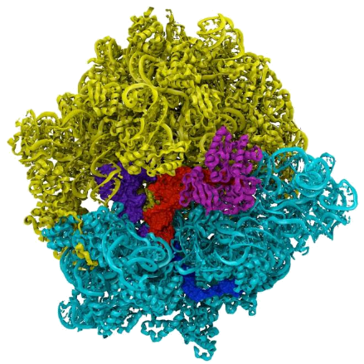
′virinal
3 pentcia′lengthel
1 hexciaGrafut 10⁻⁶_{z} Grafut
′somal
1 pentcia′lengthel
4 septciaGrafut
3 hexcia′lengthel
1 septciaGrafut
1 hexcia′lengthel
Heptatitis B
4 octciaGrafut
′ribosome-like
Ribosome
HIV
′virus-like

Slide 37
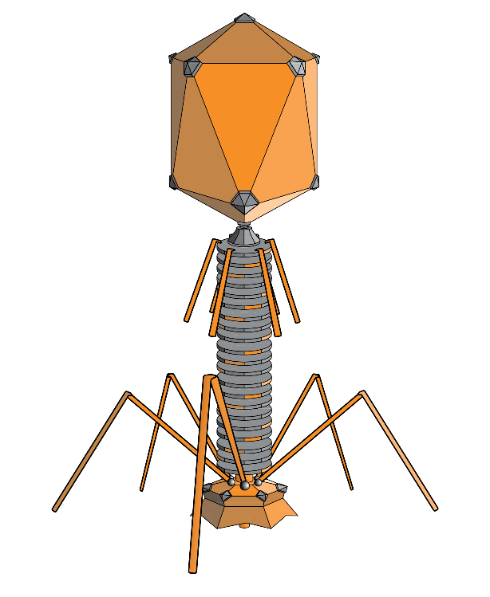
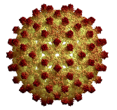
′luminal
1 quadcia′lengthel 10⁻⁴_{z} ′lengthel
4 hexciaGrafut
′virinal
3 pentcia′lengthel
1 hexciaGrafut
1 pentcia′lengthel
4 septciaGrafut
3 hexcia′lengthel
Hepatitis B
1 septciaGrafut
HIV
′virus-like
Bacteriophage
′lightwave-like
Mimivirus

Slide 38
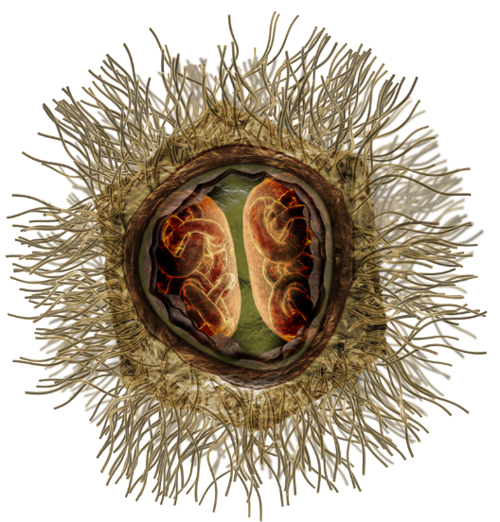
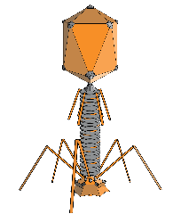
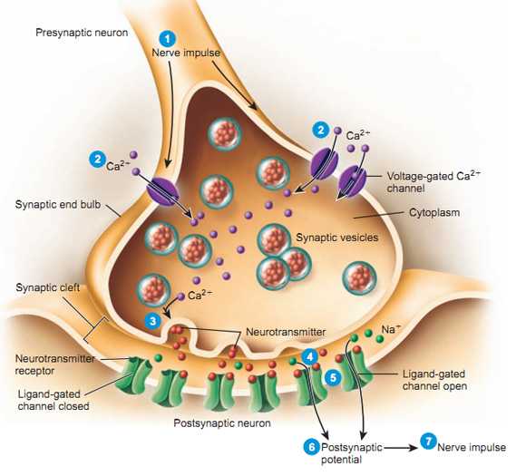
′archaeal
3 quadcia′lengthel
1 pentciaGrafut 10⁻⁵_{z} Grafut
Smallest Resolution of Optical Microscope
Violet Wavelength
′luminal
1 quadcia′lengthel
4 hexciaGrafut
3 pentcia′lengthel
1 hexciaGrafut
1 pentcia′lengthel
4 septciaGrafut
Bacteriophage
Synapse
′lightwave-like
Mimivirus
′archaea-like

Slide 39
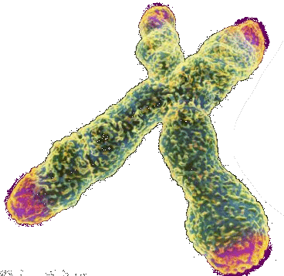
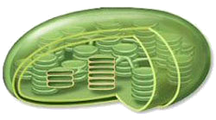
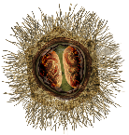
′chondrial
1 tricia′lengthel 10⁻³_{z} ′lengthel
E. coli
4 pentciaGrafut
′archaeal
3 quadcia′lengthel
Mitochondrion
1 pentciaGrafut
Violet Wavelength
1 quadcia′lengthel
4 hexciaGrafut
3 pentcia′lengthel
1 hexciaGrafut
′archaea-like
Chromosome
Red Wavelength
Chloroplast
′mitochondrion-like

Slide 40
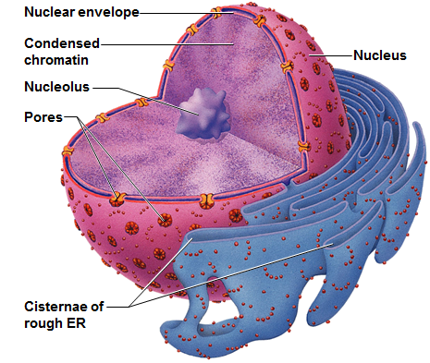
′serical
Silk
3 tricia′lengthel
1 quadciaGrafut 10⁻⁴_{z} Grafut
Erythrocyte
′chondrial
1 tricia′lengthel
E. coli
4 pentciaGrafut
3 quadcia′lengthel
Mitochondrion
1 pentciaGrafut
1 quadcia′lengthel
4 hexciaGrafut
Cell Nucleus
Chromosome
Chloroplast
′mitochondrion-like
′silk-like
Thickness

Slide 41
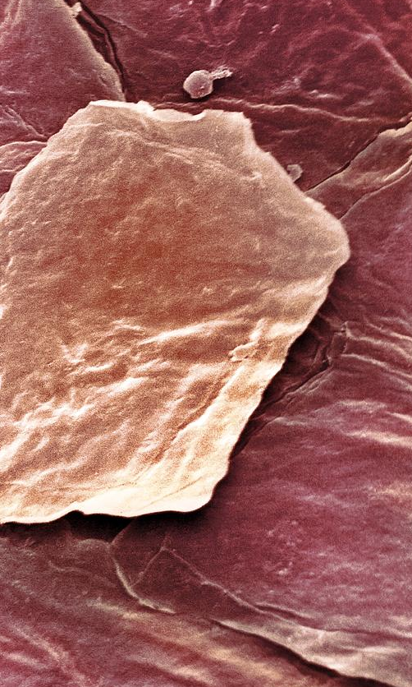
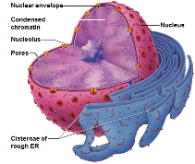
′cellular
1 bicia′lengthel 10⁻²_{z} ′lengthel
4 quadciaGrafut
Human
Ovum
Lymphocyte
Silk
′serical
3 tricia′lengthel
1 quadciaGrafut
Erythrocyte
1 tricia′lengthel
4 pentciaGrafut
3 quadcia′lengthel
Cell Nucleus
1 pentciaGrafut
Chloroplast
′silk-like
Thickness
Skin Cell
′cell-like

Slide 42
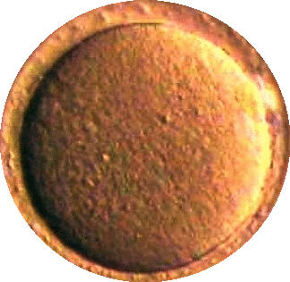
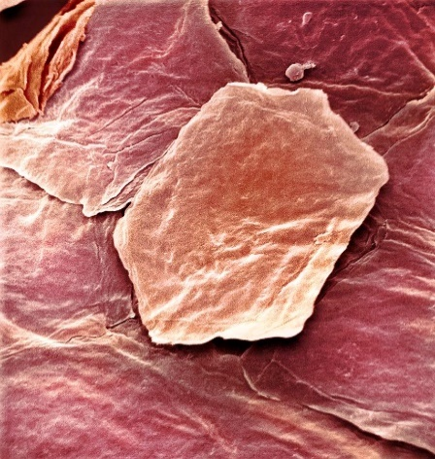
′folial
3 bicia′lengthel
1 triciaGrafut 10⁻³_{z} Grafut
Human
Ovum
Paper
′cellular
Hair
1 bicia′lengthel
3 tricia′lengthel
Silk
1 quadciaGrafut
1 tricia′lengthel
4 pentciaGrafut
Thickness
Skin Cell
′cell-like
Thickness
Thickness
Muscle Cell
′paper-like

Slide 43
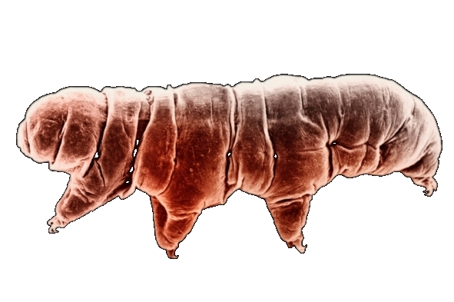
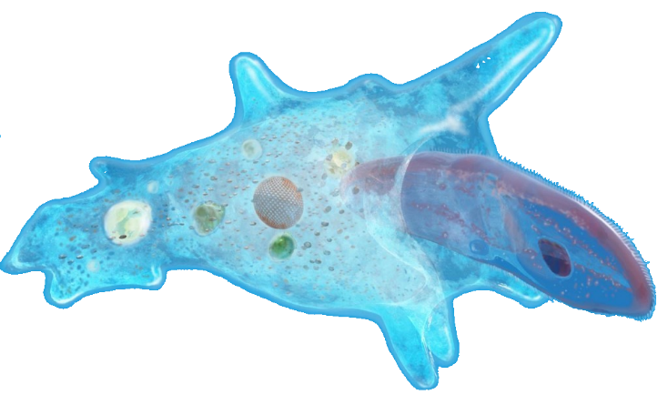
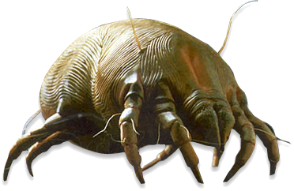
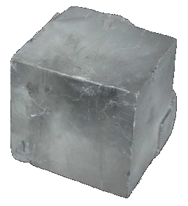
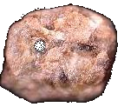
′granular
1 uncia′lengthel 10⁻¹_{z} ′lengthel
4 triciaGrafut
Amoeba
Mist Droplet
Smallest object visible to naked eye
zzzzz
Paramecium
′folial
Tardigrade
3 bicia′lengthel
1 triciaGrafut
Paper
1 bicia′lengthel
Hair
4 quadciaGrafut
3 tricia′lengthel
1 quadciaGrafut
Thickness
Thickness
′paper-like
Salt Grain
Sand Grain
Silt Grain
Dust
Mite
′grain-like

Slide 44
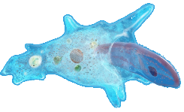
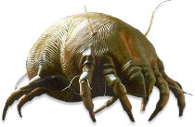
′dermal, ′linial
3 uncia′lengthel
1 biciaGrafut 10⁻²_{z} Grafut
′granular
1 uncia′lengthel
Mist Droplet
Amoeba
4 triciaGrafut
Smallest object visible to naked eye
3 bicia′lengthel
Paramecium
Tardigrade
1 triciaGrafut
1 bicia′lengthel
4 quadciaGrafut
Salt Grain
Sand Grain
Dust
Mite
Silt Grain
′grain-like
Largest
Bacteria
′skin-like, ′line-like

Slide 45
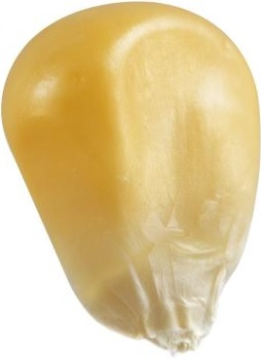
′morsel
1 ′lengthel 10⁰_{z} ′lengthel
4 biciaGrafut
Ant
′dermal
3 uncia′lengthel
1 biciaGrafut
1 uncia′lengthel
4 triciaGrafut
3 bicia′lengthel
1 triciaGrafut
′skin-like, ′line-like
Largest
Bacteria
Human
Skin
Corn Kernel
′kernel-like

