Slide 1
First, a little preview of the human scale…

Slide 2
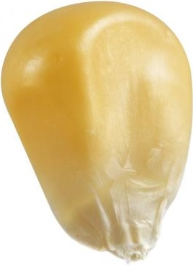
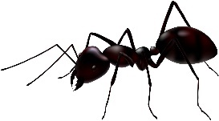
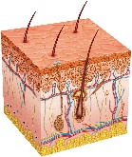
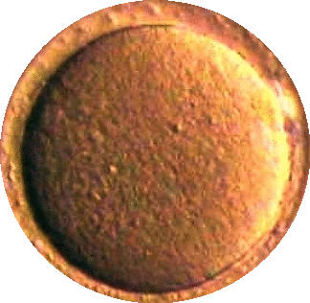
′pollical
3 ′lengthel
1 unciaGrafut 10⁻¹_{z} Grafut
′morsel
1 ′lengthel
Ant
4 biciaGrafut
3 uncia′lengthel
1 biciaGrafut
1 uncia′lengthel
4 triciaGrafut
Human
Skin
Largest
Bacteria
Corn Kernel
′kernel-like
Sunflower Seed
′thumb-like, ′inch-like

Slide 3
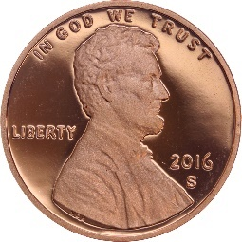
′manipular
1 unqua′lengthel 10¹_{z} ′lengthel
4 unciaGrafut
′pollical
3 ′lengthel
1 unciaGrafut
1 ′lengthel
4 biciaGrafut
3 uncia′lengthel
Quail
Egg
1 biciaGrafut
Corn
Kernel
Sunflower Seed
′thumb-like, ′inch-like
Softball
Chicken
Egg
Penny
′hand-like

Slide 4
′podial
3 unqua′lengthel
1 Grafut
′manipular
1 unqua′lengthel
4 unciaGrafut
Hummingbird
3 ′lengthel
1 unciaGrafut
1 ′lengthel
Quail
Egg
4 biciaGrafut
Softball
Chicken Egg
Penny
′hand-like
′foot-like

Slide 5
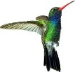
′ulnaral
1 biqua′lengthel 10²_{z} ′lengthel
4 Grafut
′brachial
′yard-like
′podial
3 unqua′lengthel
1 Grafut
1 unqua′lengthel
4 unciaGrafut
3 ′lengthel
1 unciaGrafut
′foot-like
Human
Basketball
′ell-like

