Slide 1
Now, let’s go right down to the bottom… and then climb all the way to the top…

Slide 2
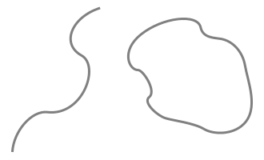
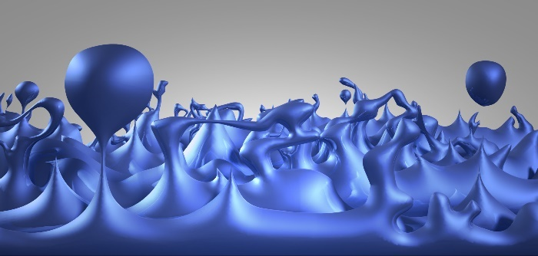
′quantal
1 bihexcia′lengthel 10⁻²⁶_{z} ′lengthel
4 bioctciaGrafut
Planck Length
3 biseptcia′lengthel
1 bioctciaGrafut
1 biseptcia′lengthel
4 biennciaGrafut
3 bioctcia′lengthel
1 biennciaGrafut
Quantum String
′Planck-like
Quantum Foam

Slide 3
3 bihexcia′lengthel
1 biseptciaGrafut 10⁻²⁷_{z} Grafut
′quantal
1 bihexcia′lengthel
Planck Length
4 bioctciaGrafut
3 biseptcia′lengthel
1 bioctciaGrafut
1 biseptcia′lengthel
4 biennciaGrafut
Quantum String
Quantum Foam
′Planck-like

Slide 4
1 bipentcia′lengthel 10⁻²⁵_{z} ′lengthel
4 biseptciaGrafut
3 bihexcia′lengthel
1 biseptciaGrafut
1 bihexcia′lengthel
4 bioctciaGrafut
3 biseptcia′lengthel
1 bioctciaGrafut

Slide 5
3 bipentcia′lengthel
1 bihexciaGrafut 10⁻²⁶_{z} Grafut
1 bipentcia′lengthel
4 biseptciaGrafut
3 bihexcia′lengthel
1 biseptciaGrafut
1 bihexcia′lengthel
4 bioctciaGrafut

Slide 6
1 biquadcia′lengthel 10⁻²⁴_{z} ′lengthel
4 bihexciaGrafut
3 bipentcia′lengthel
1 bihexciaGrafut
1 bipentcia′lengthel
4 biseptciaGrafut
3 bihexcia′lengthel
1 biseptciaGrafut

Slide 7
3 biquadcia′lengthel
1 bipentciaGrafut 10⁻²⁵_{z} Grafut
1 biquadcia′lengthel
4 bihexciaGrafut
3 bipentcia′lengthel
1 bihexciaGrafut
1 bipentcia′lengthel
4 biseptciaGrafut

Slide 8
1 bitricia′lengthel 10⁻²³_{z} ′lengthel
4 bipentciaGrafut
3 biquadcia′lengthel
1 bipentciaGrafut
1 biquadcia′lengthel
4 bihexciaGrafut
3 bipentcia′lengthel
1 bihexciaGrafut

Slide 9
3 bitricia′lengthel
1 biquadciaGrafut 10⁻²⁴_{z} Grafut
1 bitricia′lengthel
4 bipentciaGrafut
3 biquadcia′lengthel
1 bipentciaGrafut
1 biquadcia′lengthel
4 bihexciaGrafut

Slide 10
1 bibicia′lengthel 10⁻²²_{z} ′lengthel
4 biquadciaGrafut
3 bitricia′lengthel
1 biquadciaGrafut
1 bitricia′lengthel
4 bipentciaGrafut
3 biquadcia′lengthel
1 bipentciaGrafut

Slide 11
3 bibicia′lengthel
1 bitriciaGrafut 10⁻²³_{z} Grafut
1 bibicia′lengthel
4 biquadciaGrafut
3 bitricia′lengthel
1 biquadciaGrafut
1 bitricia′lengthel
4 bipentciaGrafut

Slide 12
1 biuncia′lengthel 10⁻²¹_{z} ′lengthel
4 bitriciaGrafut
3 bibicia′lengthel
1 bitriciaGrafut
1 bibicia′lengthel
4 biquadciaGrafut
3 bitricia′lengthel
1 biquadciaGrafut

Slide 13
3 biuncia′lengthel
1 bibiciaGrafut 10⁻²²_{z} Grafut
1 biuncia′lengthel
4 biteiciaGrafut
3 bibicia′lengthel
1 bitriciaGrafut
1 bibicia′lengthel
4 biquadciaGrafut

Slide 14
1 binilcia′lengthel 10⁻²⁰_{z} ′lengthel
4 bibiciaGrafut
3 biuncia′lengthel
1 bibiciaGrafut
1 biuncia′lengthel
4 bitriciaGrafut
3 bibicia′lengthel
1 bitriciaGrafut

Slide 15
3 binilcia′lengthel
1 biunciaGrafut 10⁻²¹_{z} Grafut
1 binilcia′lengthel
4 bibiciaGrafut
3 biuncia′lengthel
1 bibiciaGrafut
1 biuncia′lengthel
4 bitriciaGrafut

Slide 16
1 unlevcia′lengthel 10^{−1↋}_{z} ′lengthel
4 biunciaGrafut
3 binilcia′lengthel
1 biunciaGrafut
1 binilcia′lengthel
4 bibiciaGrafut
3 biuncia′lengthel
1 bibiciaGrafut

Slide 17
3 unlevcia′lengthel
1 binilciaGrafut 10⁻²⁰_{z} Grafut
1 unlevcia′lengthel
4 biunciaGrafut
3 binilcia′lengthel
1 biunciaGrafut
1 binilcia′lengthel
4 bibiciaGrafut

Slide 18
1 undeccia′lengthel 10^{−1↊}_{z} ′lengthel
4 binilciaGrafut
3 unlevcia′lengthel
1 binilciaGrafut
1 unlevcia′lengthel
4 biunciaGrafut
3 binilcia′lengthel
1 biunciaGrafut

Slide 19
3 undeccia′lengthel
1 unlevciaGrafut 10^{−1↋}_{z} Grafut
1 undeccia′lengthel
4 binilciaGrafut
3 unlevcia′lengthel
1 binilciaGrafut
1 unlevcia′lengthel
4 biunciaGrafut

Slide 20
1 unenncia′lengthel 10⁻¹⁹_{z} ′lengthel
4 unlevciaGrafut
3 undeccia′lengthel
1 unlevciaGrafut
1 undeccia′lengthel
4 binilciaGrafut
3 unlevcia′lengthel
1 binilciaGrafut

Slide 21
3 unenncia′lengthel
1 undecciaGrafut 10^{−1↊}_{z} Grafut
Neutrino
1 unenncia′lengthel
4 unlevciaGrafut
3 undeccia′lengthel
1 unlevciaGrafut
1 undeccia′lengthel
4 binilciaGrafut

Slide 22
′neutrinal
1 unoctcia′lengthel 10⁻¹⁸_{z} ′lengthel
4 undecciaGrafut
3 unenncia′lengthel
1 undecciaGrafut
1 unenncia′lengthel
4 unlevciaGrafut
3 undeccia′lengthel
Neutrino
1 unlevciaGrafut
′neutrino-like

Slide 23
3 unoctcia′lengthel
1 unennciaGrafut 10⁻¹⁹_{z} Grafut
′neutrinal
1 unoctcia′lengthel
4 undecciaGrafut
3 unenncia′lengthel
1 undecciaGrafut
1 unenncia′lengthel
Neutrino
4 unlevciaGrafut
′neutrino-like

